Slide 1
Innopolis-express
Team 8
Arman Kialbekov
Kirill Kuyan
Batyrzhan Zhetpisbayev

Slide 2
Initial Project Proposal
Make eating plan schedules more flexible
Reduce the pain of moving between floors after a tiring day
Exposure to larger pool of dishes to choose from.
Enhance the feeding experience of IU student.
Higher possibility for customized feeding plan to the highest extend.

Slide 3
Quality of the interview transcript
Requirements elicited from interviews has some contradictions with use cases.
Examples: Website but mobile app; no registration.
No traceability between the interviews and use case.
Unclear how initial requirements eventually changed.
Users’ expectations changed at some moment.
It is obvious in comparison to the final use cases.

Slide 4
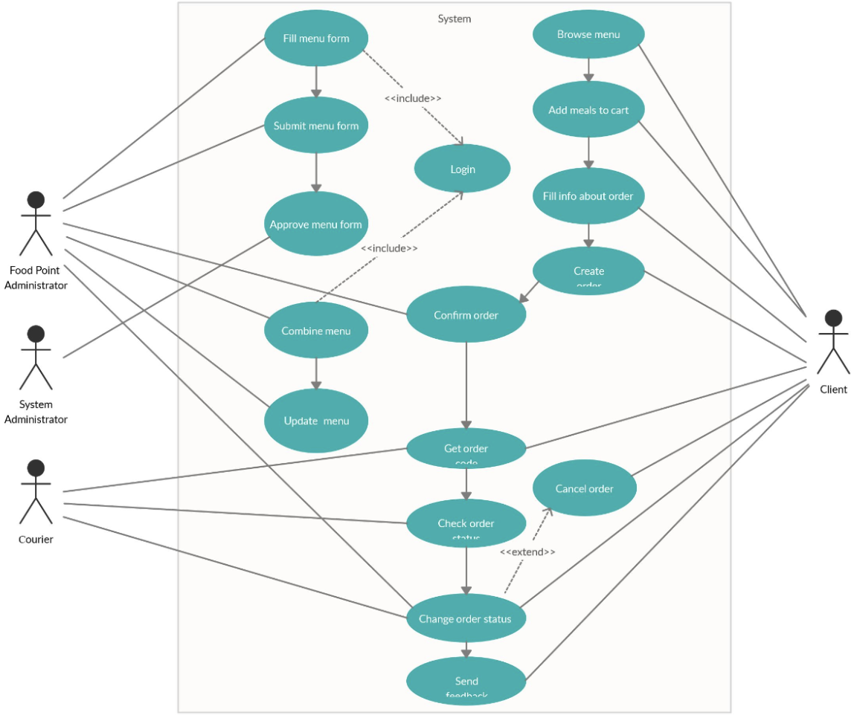
Initial use case diagram

Slide 5
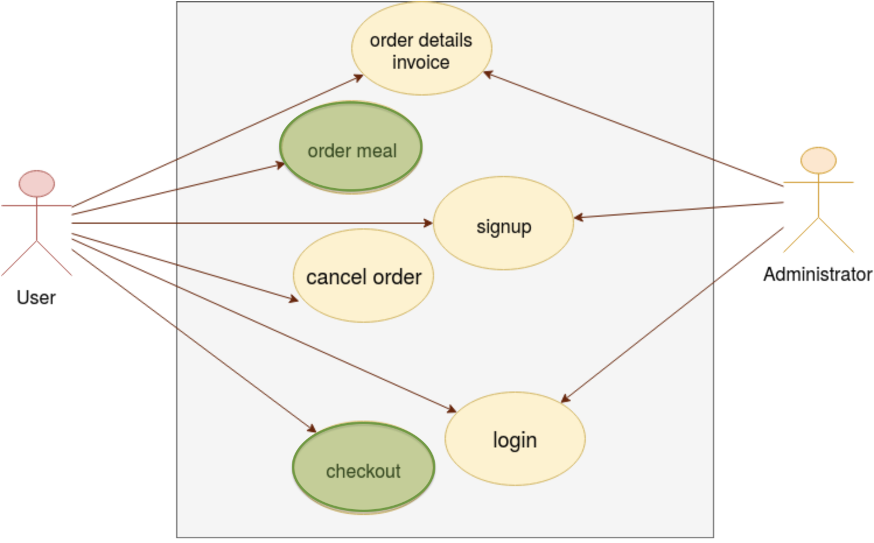
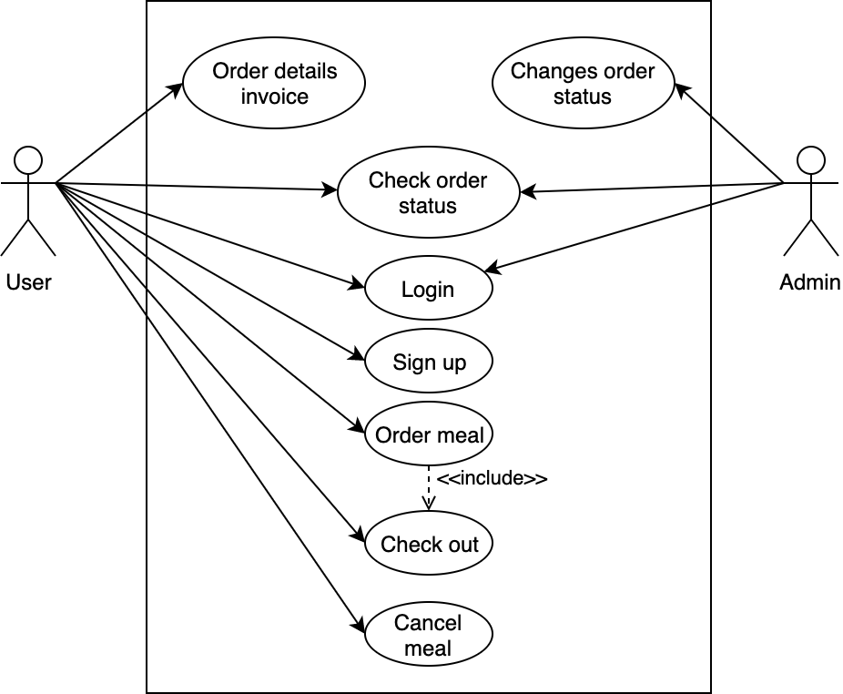
Use case evolution
Iteration 2
Iteration 3

Slide 6
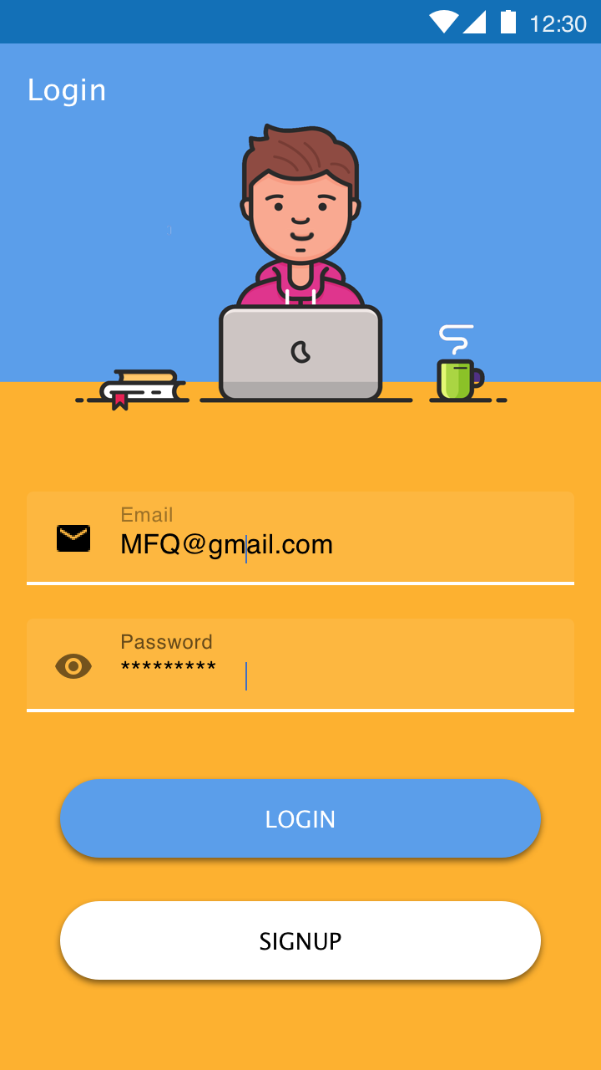
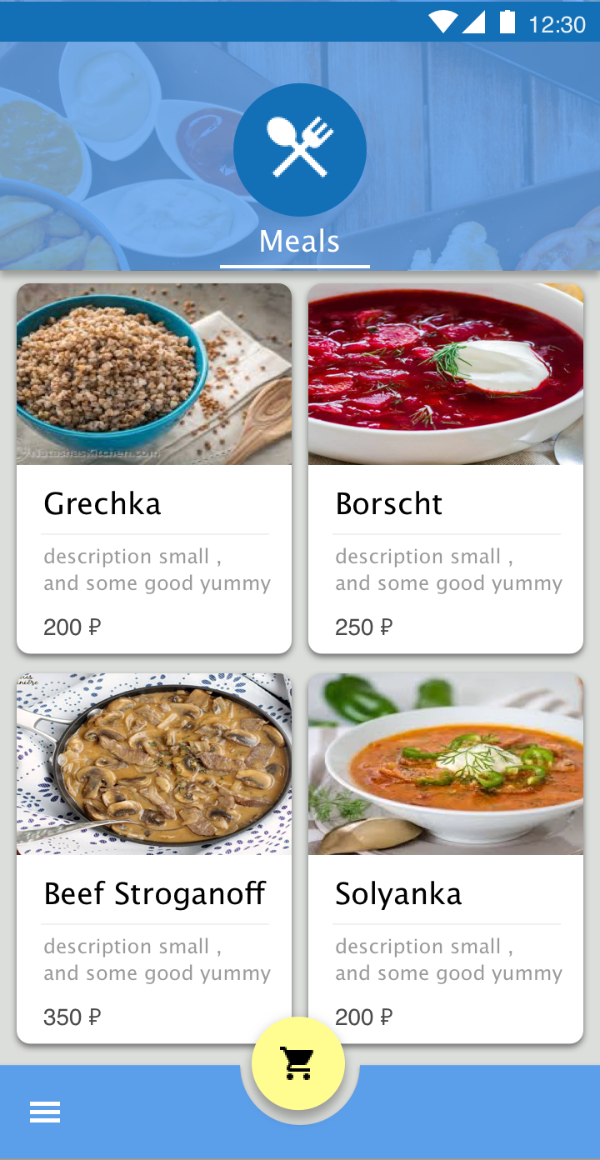
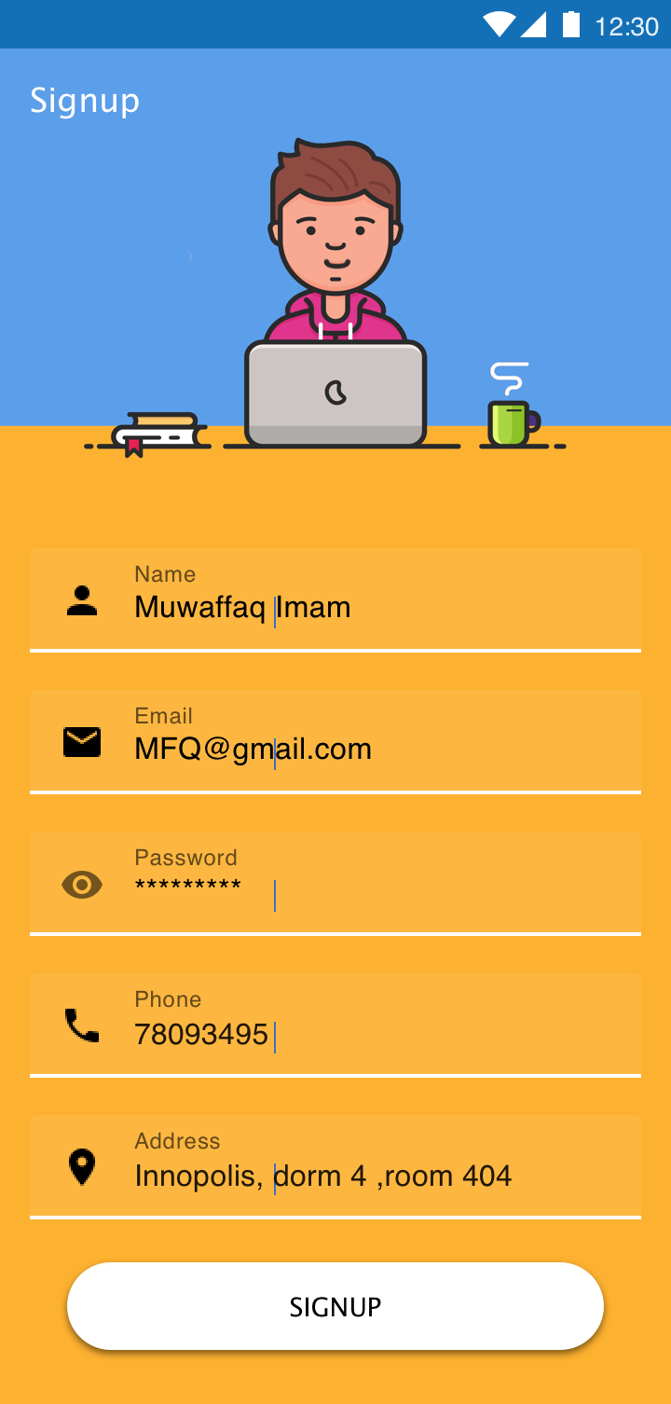
MVP and UI

Slide 7
Teamwork, communication with other
Positive:
Hand-in of the iteration 2 was helpful
All decisions on requirements changes were agreed with the customer
Negative:
Waited for a long time while the customer will accept and merge the MVP on iteration 2

Slide 8
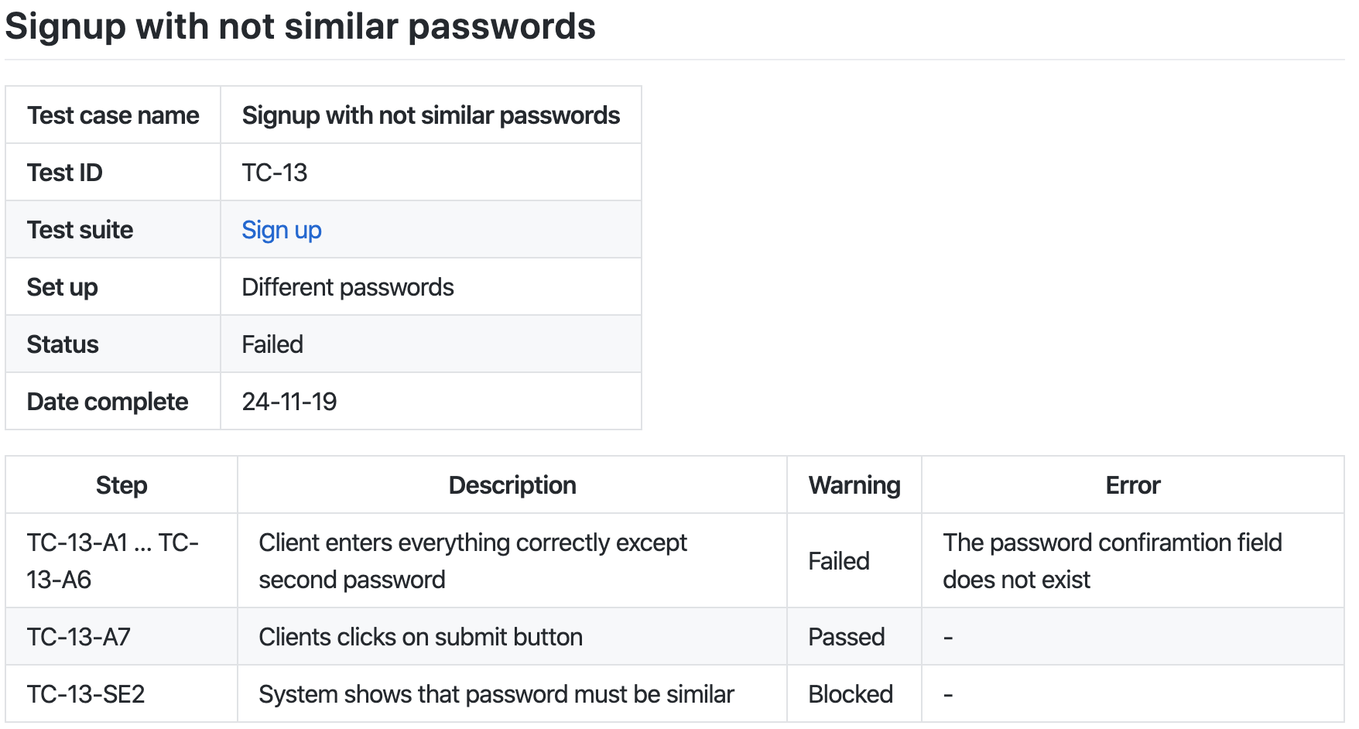
Quality management
Test cases
Total | 23
Failed | 1
Warning | 1

Slide 9
Demo

Slide 10
Strengths
Weaknesses
Full stack implementation of the service: client app, server, hosting, database, storage
Real time update of information
Comprehensive UI design
Gaps in User Experience and Interactions derived from use cases
Client app is available only on Android
Unreasonable initial architecture decisions

Slide 11
Lessons learned
RE project - is a broken telephone game
Traceability matters
All decisions must be documented
Requirements are constantly changing in every iteration

Slide 12
Thank you for paying attention!

